Slide 1
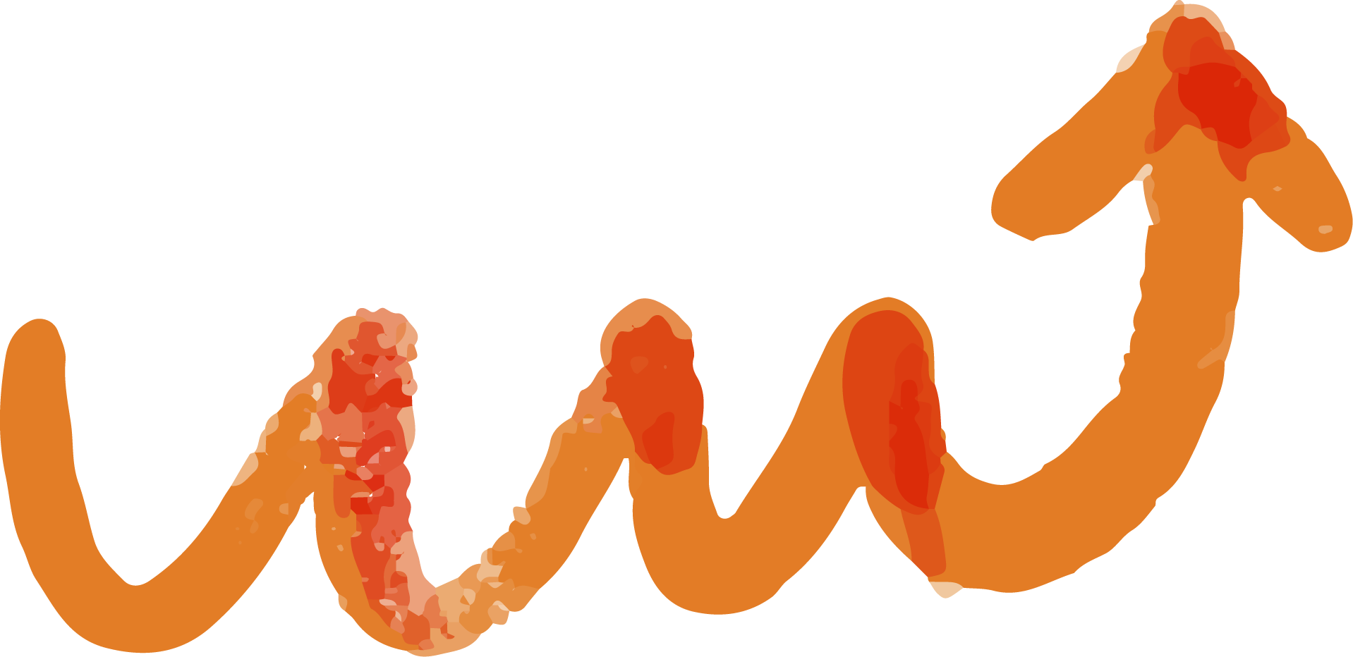
IMAGINE 2024 STRATEGY
Technically Speaking

Slide 2
TABLE OF CONTENTS
01
02
03
04
05
06
RESEARCH
FINDINGS
AUDIENCE
GOALS AND OBJECTIVES
STRATEGIES
FUTURE CONCEPTS

Slide 3

OUR RESEARCH JOURNEY
STEP 1
STEP 2
STEP 3
Familiarized our copy and art team with Imagine RIT’s previous messaging and goals
Looked into previous promotional elements, both of Imagine and similar competitions
Analyzed focus group information
STEP 4
STEP 5
Referenced our own experiences with the event in previous years
Conducted primary survey research distributed online

Slide 4

PROMINENT FINDINGS
VALIDATED PREVIOUS FOCUS GROUP RESEARCH
Few are aware of the full scope of events present at Imagine RIT
First year students especially have less awareness of Imagine RIT as a whole
Those who attend one year are much more likely to attend in some capacity again in the future
Students feel inspired by the exhibits they experience
Students feel especially motivated to attend through a connection with those exhibiting
Notes:
Possibly due to the influx of off-campus, describe awareness, and acceptance issues

Slide 5
PROMINENT FINDINGS (CONT.)
IDENTIFIED ADDITIONAL BEHAVIORS
Students utilize many different media when uncovering news or making decisions to attend campus events
Students do not access all the information available around Imagine
Major reasons for non-attendance among those with awareness:
  Not interesting/relevant to them personally
  Appeared overly crowded, especially with non-student populations
Notes:
Whether from not keeping up with email messaging and more, students are generally Possibly due to the influx of off-campus, describe awareness, and acceptance issues

Slide 6

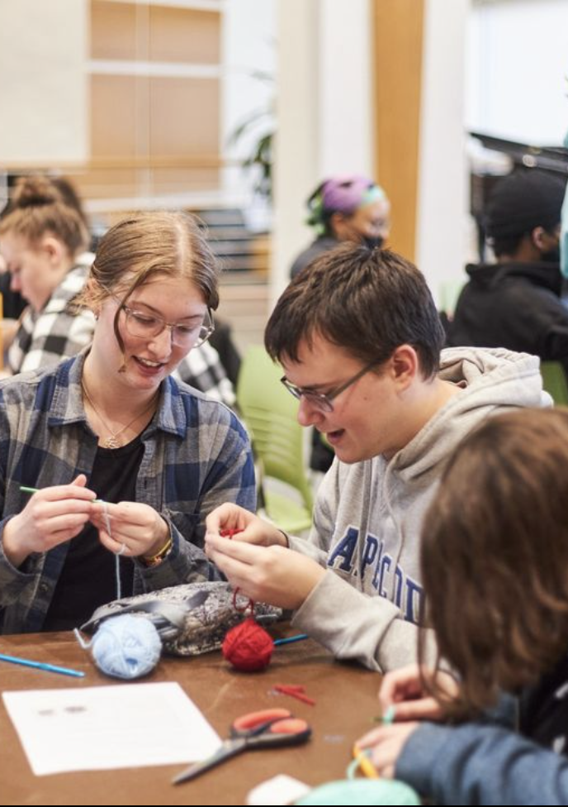
AUDIENCE
Actively targeting students at RIT, but also:
looking to jumpstart increased engagement in underclassmen that will lead to increased exhibitors and more in years to come
Ultimately looking for a sense of pride in the school
Underclassmen:
Live in on one of two areas on campus (dorms; GV)
Generally seek out belonging in some sort of club/organization
Are still forming their student experience at RIT
Generally enjoy media that is more humorous and engaging
@ritstudentlife
Notes:
Following the Imagine RIT experience life cycle, investment in future Imagine events

Slide 7
CAMPAIGN GOALS AND OBJECTIVES
#1
#2
To promote a sense of excitement for Imagine RIT amongst the student body.
To increase awareness of exhibits and events present at Imagine.
#3
#4
To elevate connection between students of different interests and programs.
To improve both the attendance, and experience of students.
Measurables: Web Traffic, Social Media Performance, Passports Distributed

Slide 8
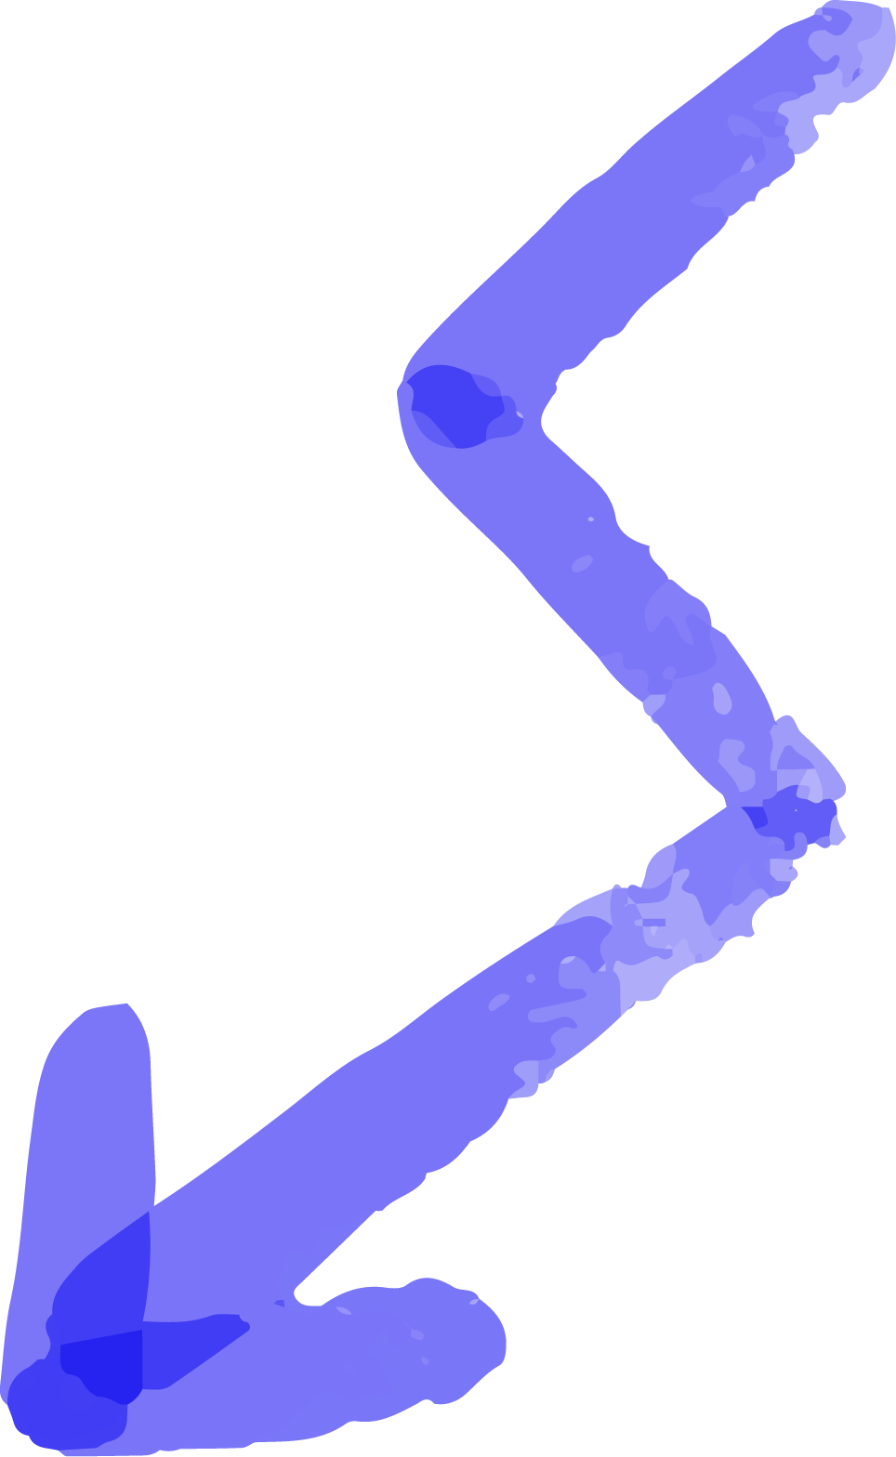
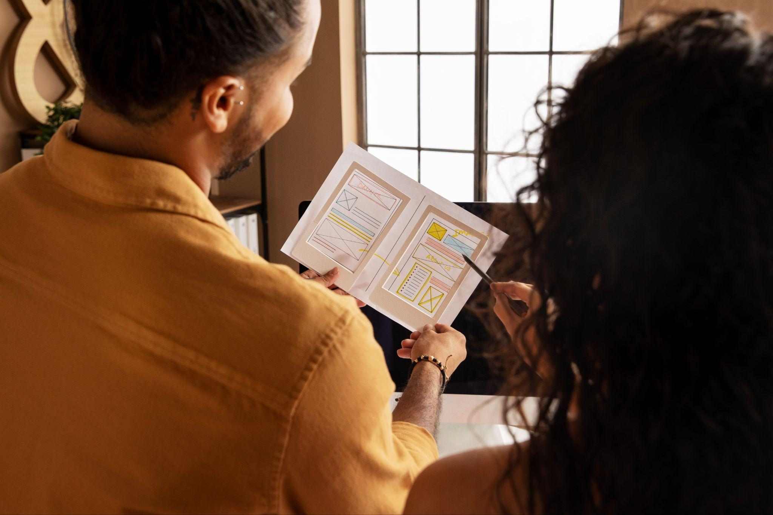

STRATEGY TALK

Slide 9
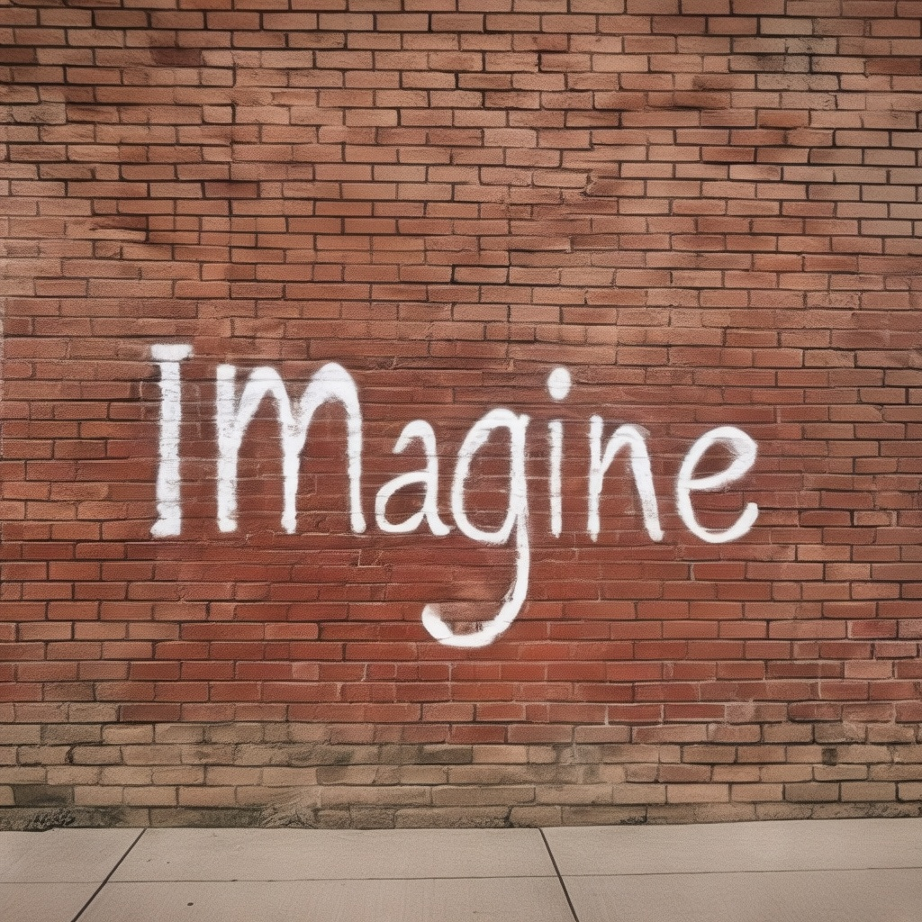
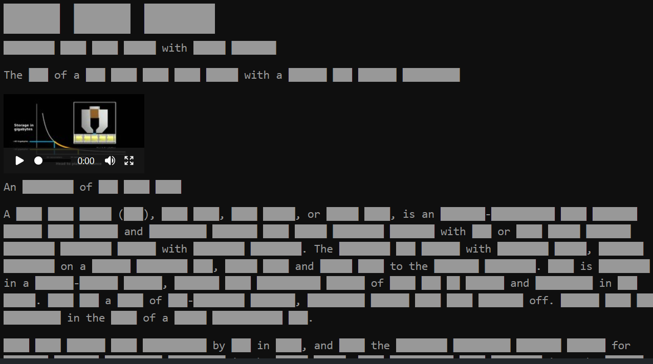

STRATEGY #1: CREATE INTEREST
IMAGINE TEASER CAMPAIGN
To generate anticipation for Imagine RIT, providing students with curiosity that can only be resolved by seeking out more info.
Conversation Starter: Guerilla Chalk Art
Website Visits: Exhibit RIT-actile
Social Media Push: Teaser Unveiling
Notes:
We view a lot of our overall strategy as being supplemental to the information you’re already providing, as such we’ve geared much of our overall communication direction towards giving students reasons to access spaces where information around Imagine resides. Using the released map as a framework or wordbank, students will guess words from the exhibit bios as they attempt to learn the major players from each section Students will have the opportunity to guess the social media event described the following day.

Slide 10
STRATEGY #2: DIFFUSE INFORMATION
KEY PLAYERS CAMPAIGN:
To identify the individuals involved within Imagine, making the event feel more relevant to students on a personal level.
Social Media:
Exhibit Profiles from Each Zone
Interviews With Personnel
Digital:
Campus Groups Banner Ad
Map and Share Routes
Reference Groups:
Professors/Staff Outreach
RA Material Delivery
Notes:
Capitalizing on the increased buzz. Interviews/prominent events (featuring students from all of STEAM) Professors, especially program directors reach out to students to notify them of others in their programs exhibiting this year

Slide 11
STRATEGY #3: INCENTIVIZE ACTION
PASSPORT CAMPAIGN:
To highlight the different zones that make up RIT, and provide students a tangible reason for engaging.
Students receive a pocket sized booklet “Passport”
These students travel through different zones at Imagine RIT, collecting unique stickers for this booklet as they fill out their passport
Stickers embody all the potential of Imagine exhibits, displaying distinctive elements of each zone
Booths distributing stickers may be the same as those spotlighted in previous campaign
Potential for reward upon presentation of a complete passport
Notes:
Embodies all the potential of imagine exhibits!!!

Slide 12
PASSPORT - LOOK AND FEEL
OVERALL VIBE:
Passport printed on nice cardstock, meant to be cherished and kept
Stickers should feel exciting, being previously spoiled on social media and outlined on each page
WHAT’S ON EACH PAGE?
Campus map- identifying each zone- highlighting what zones have stamps and where special zones are
A direction guide- explaining how the passport works
List of highlighted exhibitors
4-11. Pages dedicated to each zone- and a place where the stamp will be

Slide 13
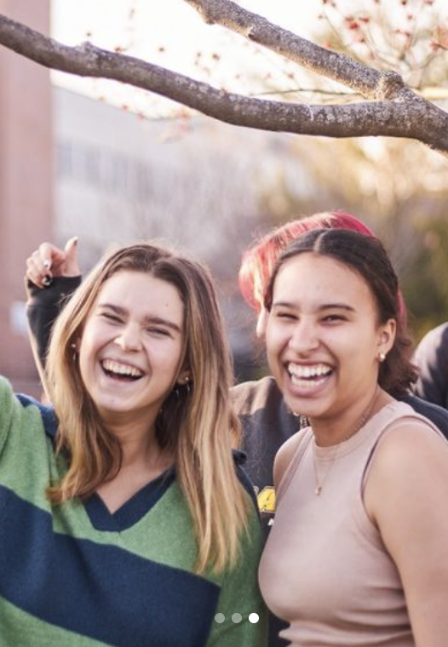
“VIP” STUDENT ZONES
Students flash their passport to gain access to select “VIP” rooms around campus
Spaces will be reserved as more relaxing spaces from students to recharge from crowds
Promoted on social media, as well an unspoiled sticker received only by visiting one of these spaces.
@ritstudentlife

Slide 14
Additional Opportunities
Inter college olympics - expansion of zone concept, counting stickers
Imagine expanding the passport idea to mailing it out to students directly with their photo and information on it
Displaying nostalgic content from Imagine outside of the event window/year-round
Interesting new media posts like on Reddit
Leveraging student run media: The Reporter, WITR
Connect with student influencers/Ritchie to live share their experience
Notes:
Following the Imagine RIT experience life cycle, investment in future Imagine events

Slide 15


Discussion
Questions and/or Feedback?

Slide 16



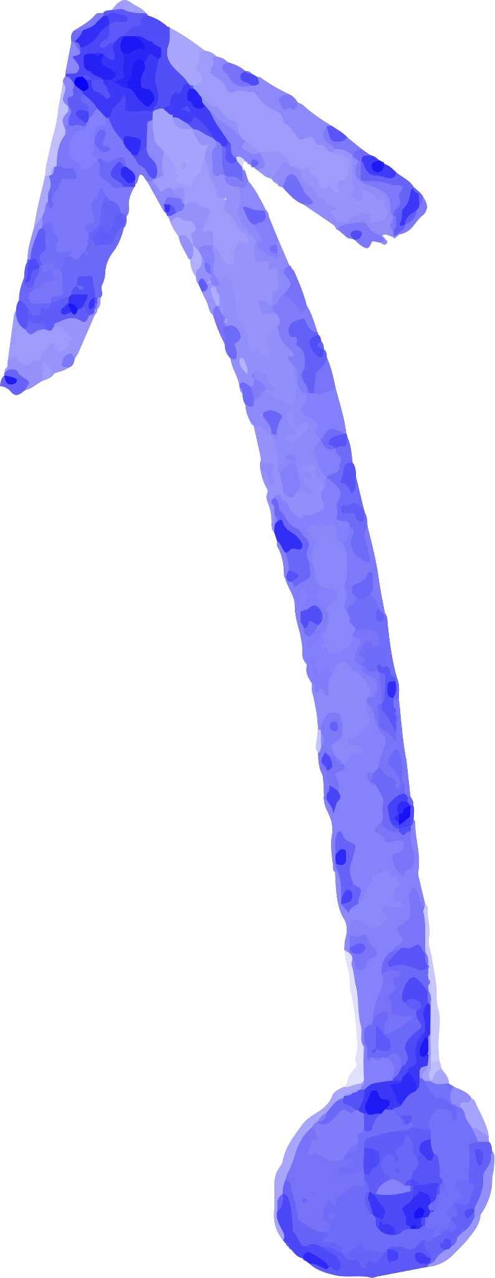





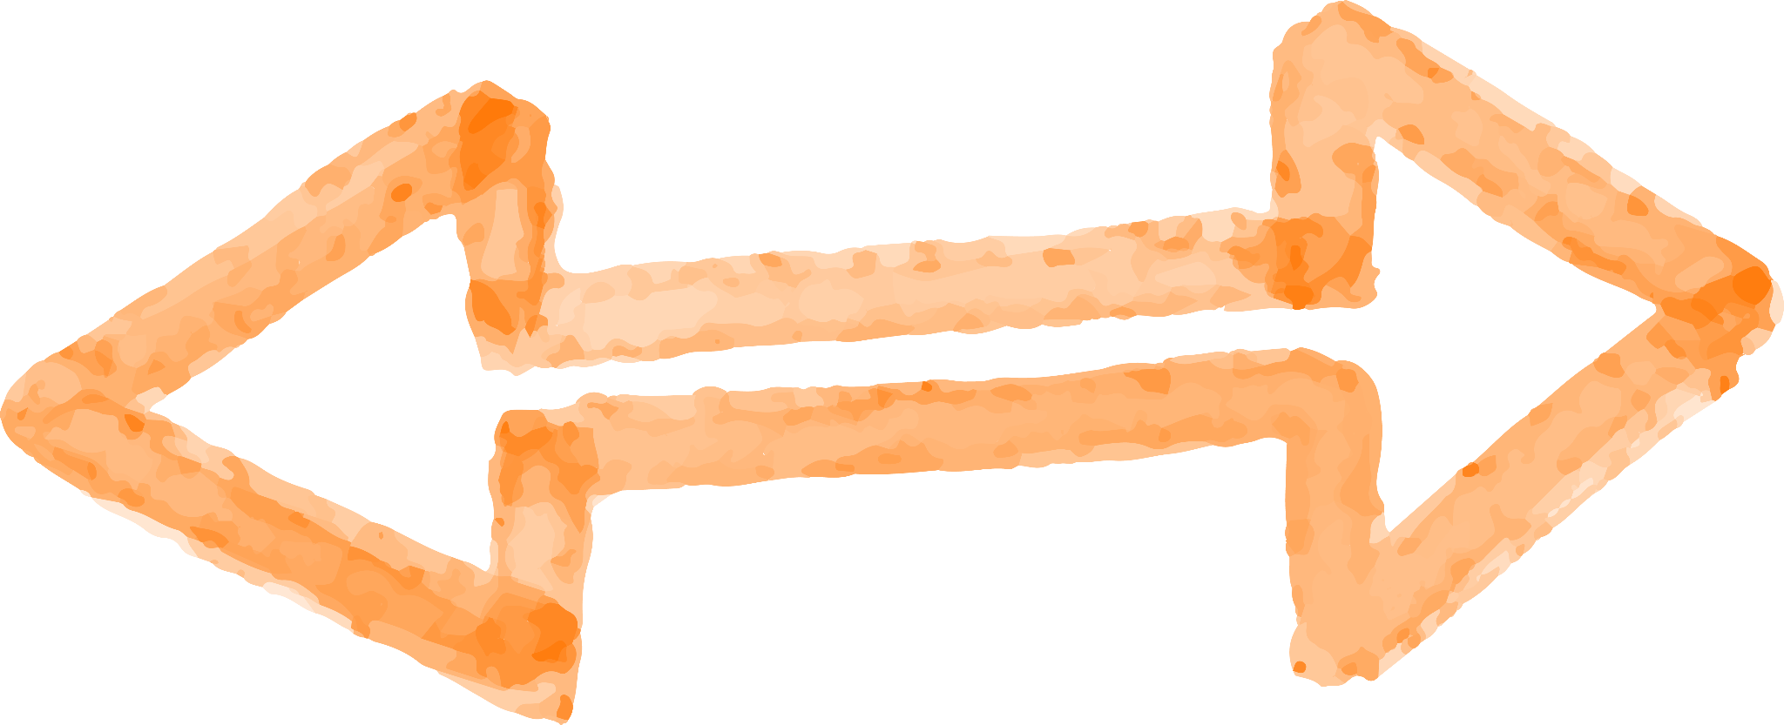
ALTERNATIVE RESOURCES
Here’s an assortment of alternative resources whose style fits the one of this template:
Vectors
Collection of marker arrow
Brush strokes collection

